Slide 1
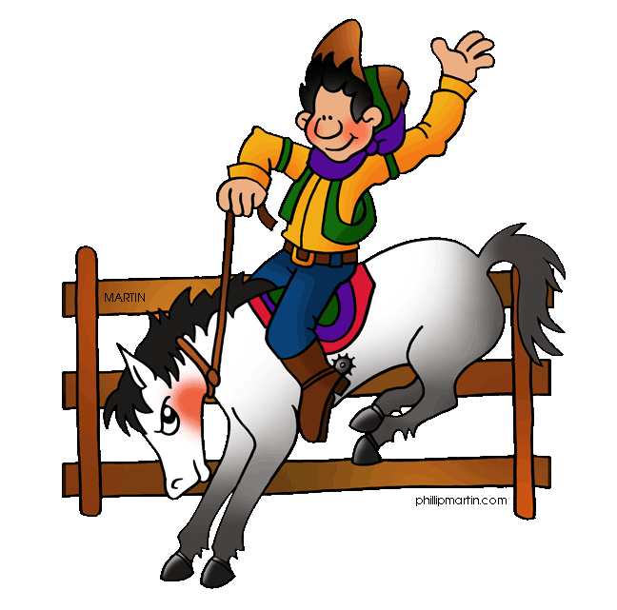
Kindergarten Round-Up
West Orange-Stark Elementary
Friday, May 4,2018
7:00-11:oo a.m.
Bring Birth Certificate, Social Security Card,
Immunization Records and Proof of Residency
(ex. Electric bill or lease agreement)
Registration is for students new to the West Orange district.

